Slide 1
HEC Montreal Summer school Management of Creativity in an Innovation Society
Jean-Alain HERAUD
BETA/UdS Strasbourg
Session « From the Creative city to the Creativity of Cities »
3 July 2010
Strasbourg and the Region Alsace:
Creativity from the Renaissance. Renaissance of creativity?

Slide 2
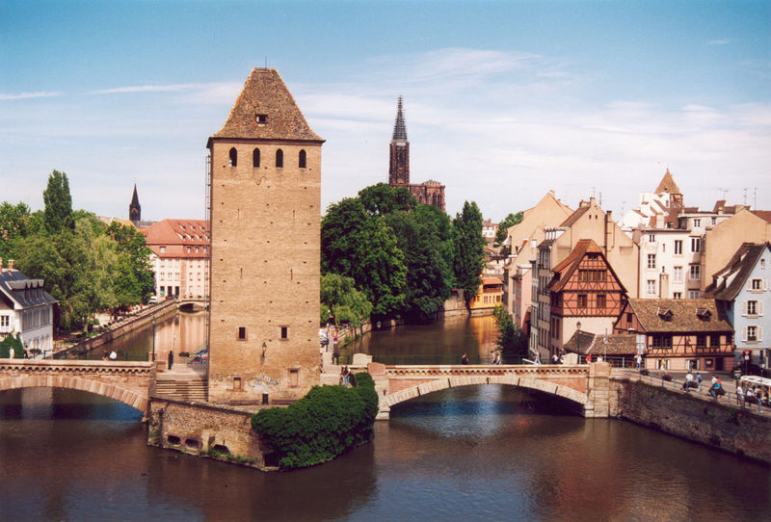
Strasbourg Stràsburi Straßburg
Identity (ies) ?
L’Alsace s'Elsàss dasElsaß

Slide 3
What is Alsace?
1. One of the 22 French « Regions »
(metropolitan France)
Traditionnally industry-oriented, but recently evolving towards tertiary activities

Slide 4
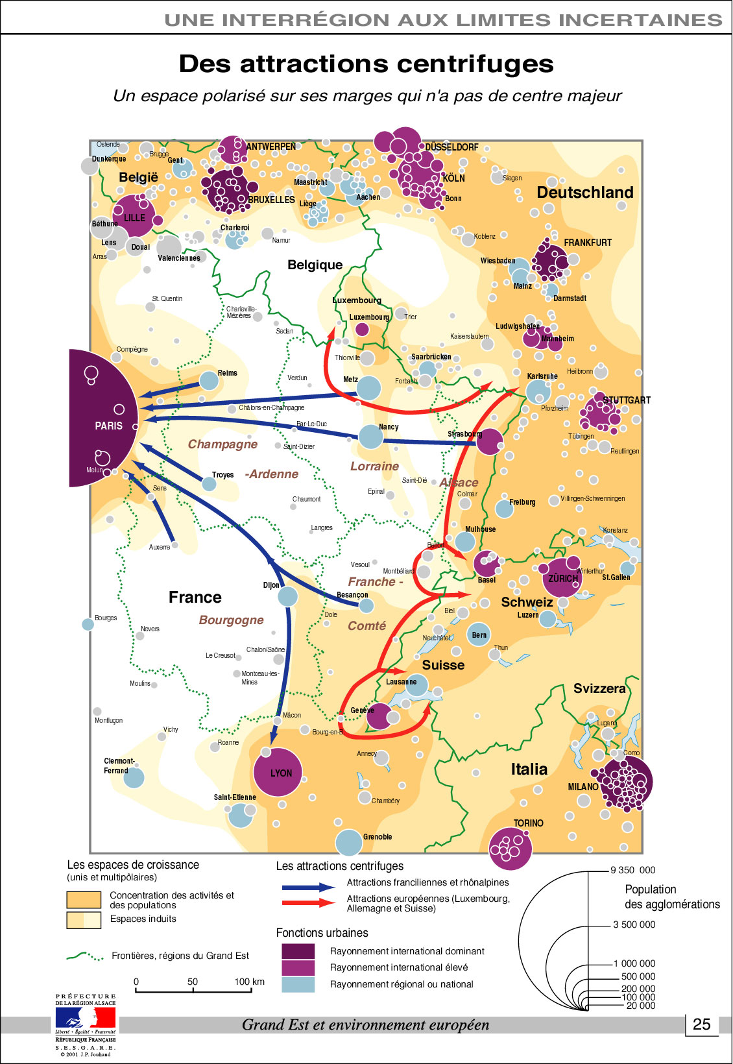
What is Alsace?
2. An area geographically and historically rooted in the Upper Rhine Valley

Slide 5
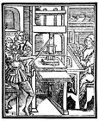
History Tradition of creativity and innovation in the Upper-Rhine area
Johannes GUTENBERG
Born: Mayence (Mainz) around 1400
Has worked in Strasbourg
**********************
Religion: protestantism
Litterature: Sebastian Brandt
Painting,
Architecture,
etc.

Slide 6
Where is Alsace?
3. Institutionally at the heart of Europe:
European Parliament in Strasbourg
plus many other European institutions:
Council of Europe
Europ. Court of Human Rights
Assembly of European regions
Etc….
European Parliament in Strasbourg

Slide 7
What is Alsace?
4. A future transborder European region?
Institutional projects with neighbouring German and Swiss regions:
Upper-Rhine as a « Small Europe »
Exemples:
* EUCOR (Universities)
* Regional Trinational Metropolitan Region
(Rhin Supérieur/Oberrhein)
Conseil rhénan
Eurodistrict Strasbourg-Ortenau

Slide 8
Upper Rhine: Europe’s R&D and Education golden triangle
167,000 students
20,000 researchers
Highest concentration of R&D in Europe
Region of excellence
with numerous research centers and start-ups

Slide 9
Regional mapping of the
« economics of knowledge »
in Europe
Share of knowledge workers
2006

Slide 10
TMR Upper Rhine: Science and Research Map
Many institutions in the Upper Rhine: - 9 Universities and 64 further institutions of higher education and applied sciences with about 167'000 students - 43 institutions in the area of technology transfer and innovation promotion - 21 institutions for environmental, agricultural science and energy - 14 Life Sciences institutions
+ EUCOR - European Confederation of the Upper Rhine Universities

Slide 11
A world-known trinational cluster in life sciences
As a unique project established in the heart of Europe, bringing together Alsace in France, South Baden in Germany and Northwest Switzerland, with as centers Strasbourg, Freiburg and Basel, BioValley was one of the first European initiatives for the promotion and the development of life sciences. It has grown to become one of the leading life sciences regions in the world.

Slide 12
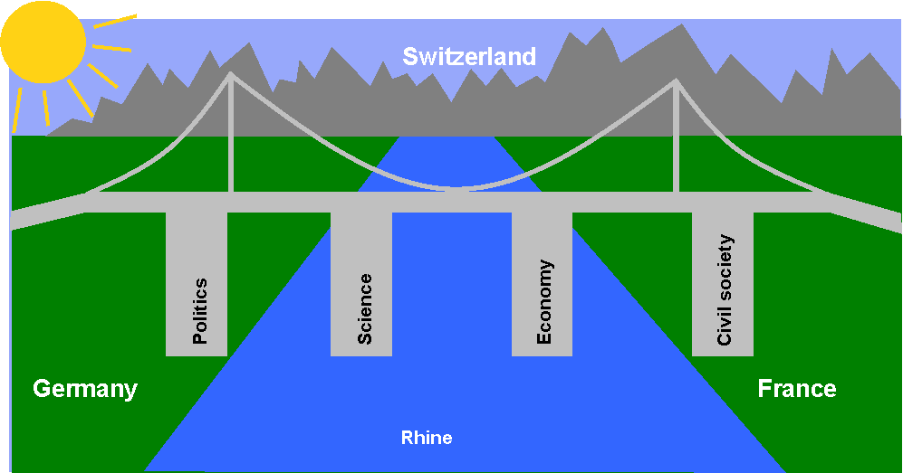
The TMR ambition
The common decision of the stakeholders
of the Tri-national Metropolitan region Upper-Rhine:
“To become the most dynamic knowledge-based transnational economic area of Europe by 2020 ”
A laboratory for the implementation of the Europe 2020 strategy

Slide 13
Upper-Rhine area: opportunities and difficulties
Volume and variety of the local endowment (science, technology, culture, …) is a potential for innovation but not a sufficient condition.
Critical mass means interlinking assets.
Variety of institutions, cultures and languages is an advantage in terms of evolutionary models, but it increases transaction costs in the short run!

Slide 14
Issues and challenges: 1. Distributed academic strengths
Not one big university but several « universities of excellence » along the Rhine.

Slide 15
Issues and challenges:
2. Critical mass for knowledge-based activities:
The case of KIBS (business services)

Slide 16
Issues and challenges
3. Critical mass for activities in typical creative industries
Indicators of centrality
(large urban agglomerations)
Paris, London: class 1
…..
Strasbourg: class 5
Ranking on 15 indicators

Slide 17
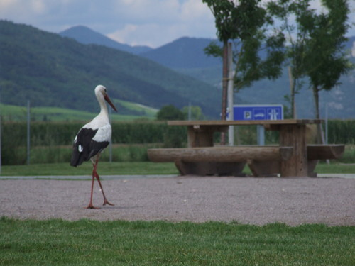
Issues and challenges specially for Alsace
Alsace has some typical characteristics of the Upper-Rhine area : strong middle-tech industry, not enough creativity-based activities.
It definitely has a cultural and sociological identity but it is not a full-fledged regional innovation system (RSI coherence problem)
Alsace facing its future

Slide 18
Issues and challenges specially for Alsace
Economic development should not be restricted to traditional industry
- even if relatively dynamic and successful, partly following the strong SME model of « Mittelstand », typical of tneighbouring German regions

Slide 19
Issues and challenges specially for Alsace
Culture-based activities should not be restricted to touristic attractions
-even if quality of life is part of the attractivity and therefore of creativity

Slide 20
Conclusion
Economie et technologie
Science et éducation

